Slide 1




Introduction to HPC in Computational Modelling PATC: HPC-based simulations, Engineering and Environment with applications in Bioengineering
Marco Verdicchio
SURFsara
This project has received funding from the European Union’s Horizon 2020 research and innovation programme under grant agreement No 675451.

Slide 2
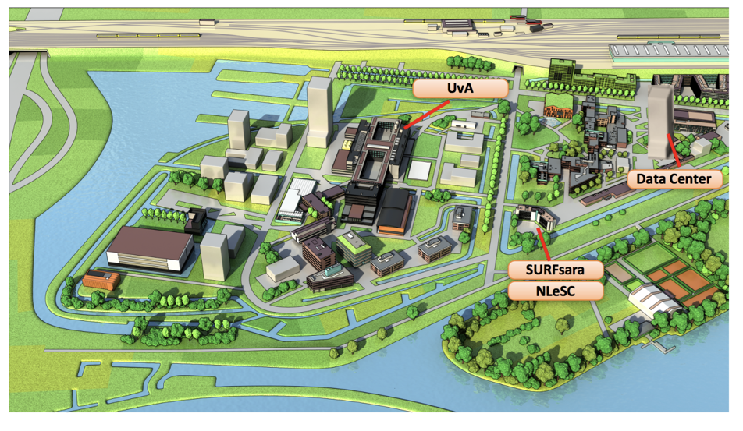




HPC at SURFsara
HPC Consultant in the Supercomputing Team
Science Park, Amsterdam
About 70 op. people
50% Consultants
50% System programmers

Slide 3
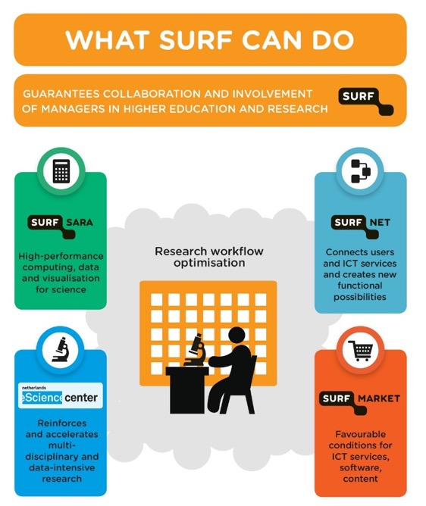
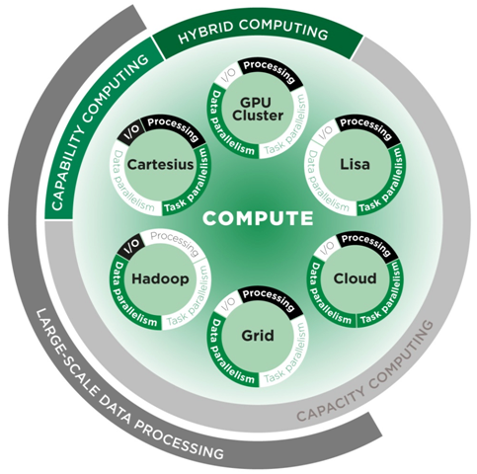
HPC at SURFsara

Slide 4
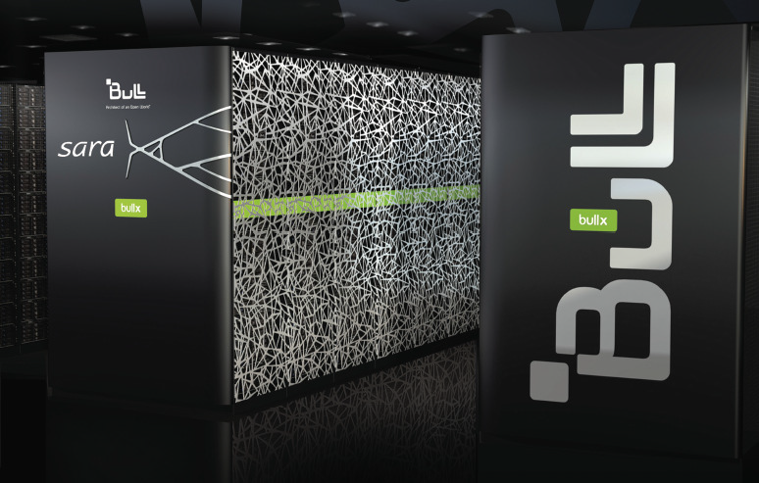
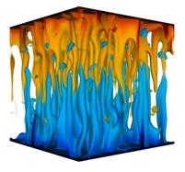



HPC at SURFsara
Maintain Cartesius and Lisa
User support
Training
Development and Innovation
Involvement in EU projects
Intel Parallel Computing Center

Slide 5
Introduction to HPC - Outline
What is a Supercomputer?
Working on a Supercomputer
Supercomputer access and usage
Getting started with HPC
Linux basic command
Bash scripting
Running jobs
Use the batch system
Execute parallel programs

Slide 6


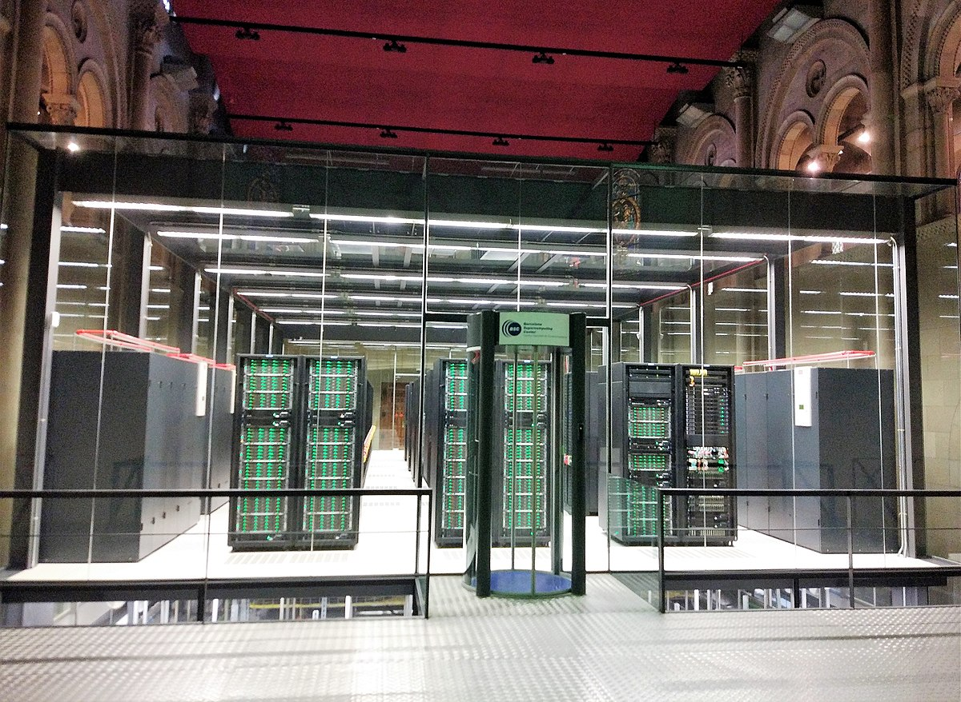

What is a Supercomputer?
User Experience
Multiuser system
Unix OS
Optimized software
Compute power
Many CPUs system
Specialized Hardware
Low-latency/High bandwidth Connections
Storage
Efficient I/O
Large Memories
Cartesius, SURFsara (NL)
Marenostrum, BSC (ES)

Slide 7
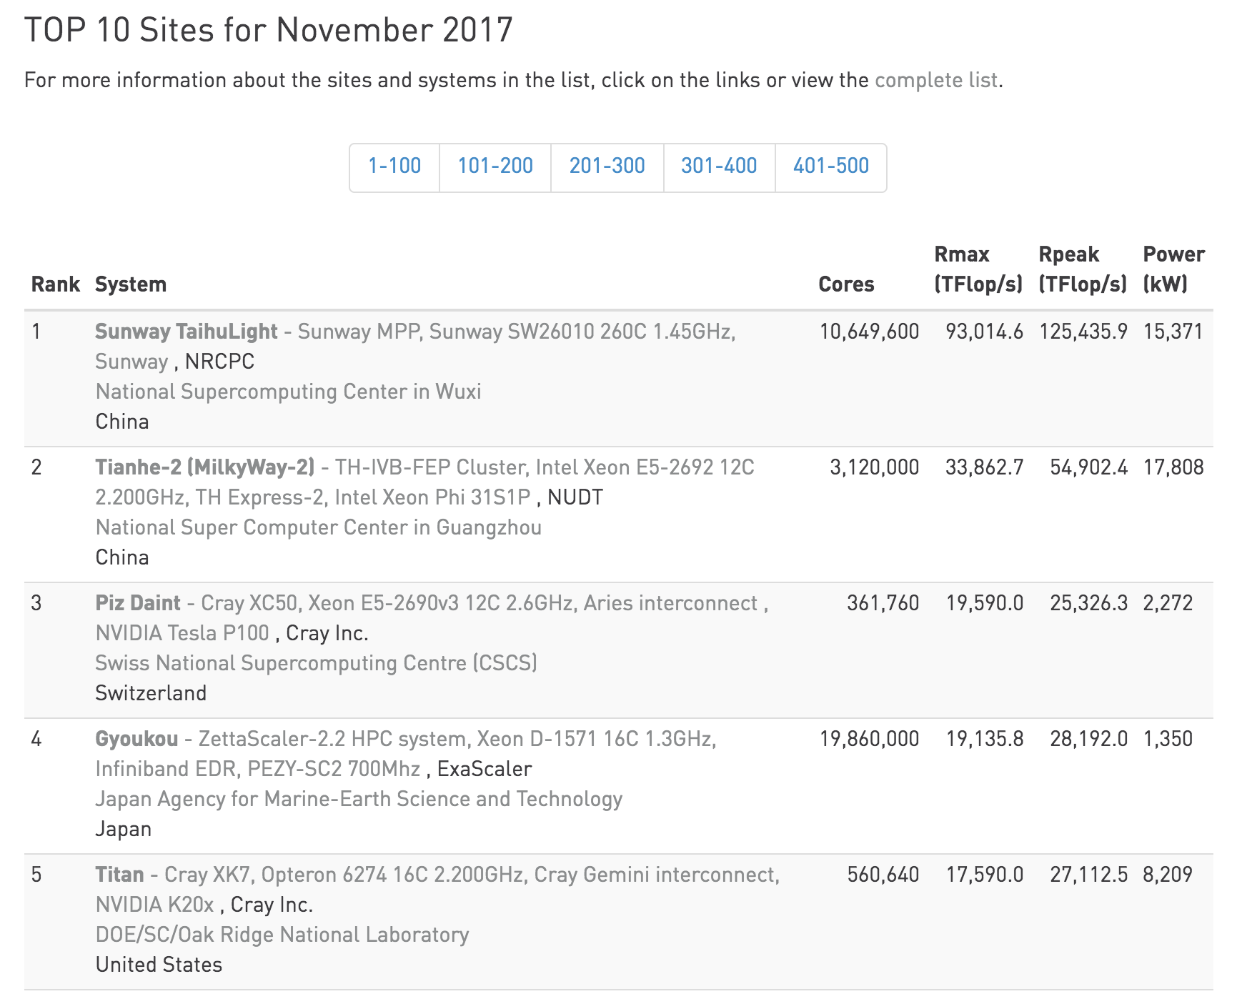
What is a Supercomputer?
www.top500.org

Slide 8

What is a Supercomputer?
Why, or more, when you need a Supercomputer?
Scale up
Faster CPUs
Large memories
Specialized Hardware/Software
Scale out
Large parallel applications
Many small- to medium- size jobs
UP
OUT

Slide 9
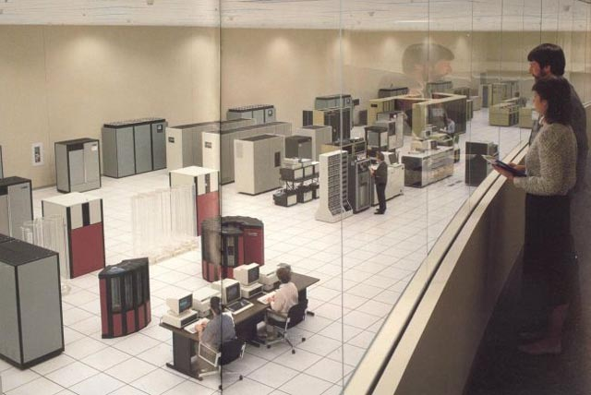
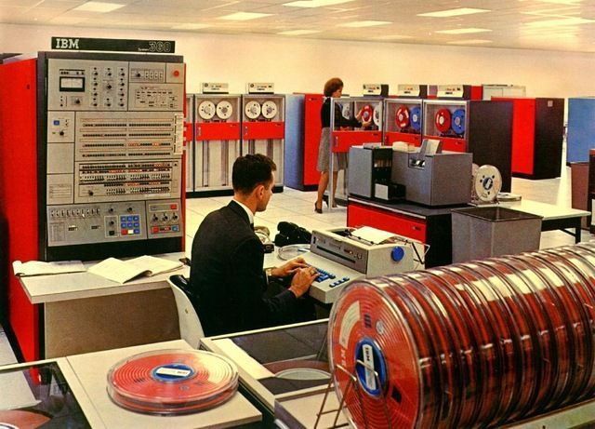
Working with a Supercomputer
Is NOT like this…

Slide 10
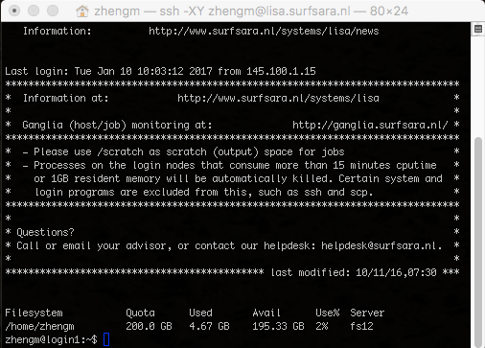
Working with a Supercomputer

Slide 11




Working with a Supercomputer
ssh
Job
Submission
Batch scheduler
Login Node
USER
Shared
Filesystem
Compute
Nodes

Slide 12
Working with a Supercomputer
Login node(s)
Editing and transferring files
Compile programs
Prepare simulations
Compute nodes
Multicore nodes
Large memories
High-speed interconnections
Batch scheduler
Resource allocation
Job queueing
Accounting and
File system
Parallel FS
Efficient I/O
Node local disks

Slide 13
Working with a Supercomputer
Login and transfer files to the remote machine
ssh, scp/ftp
Command line, GUI
Prepare your job(s)
Input preparation
Job submission script
Software preparation
Submit your job and retrieve output
Submit job to the batch system
Monitor job
Retrieve outputs / Remote visualization

Slide 14
Getting started with HPC
Login to an HPC system
Introduction to HPC in Computational Modelling

Slide 15
Login to an HPC system
Getting an account on the system
EU funded projects (PRACE, CompBioMed, etc.)
National initiatives (NWO, RES)
Special agreements with Universities or research centers
Contact the HPC center
helpdesk@surfsara.nl
support@bsc.es

Slide 16
Login to an HPC system
Install UNIX tools on your local machine
Windows
Putty
MobaXterm (http://mobaxterm.mobatek.net)
Mac OSX
Terminal (pre-installed)
XQuartz (http://www.xquartz.org)
Linux
You are already well equipped!

Slide 17
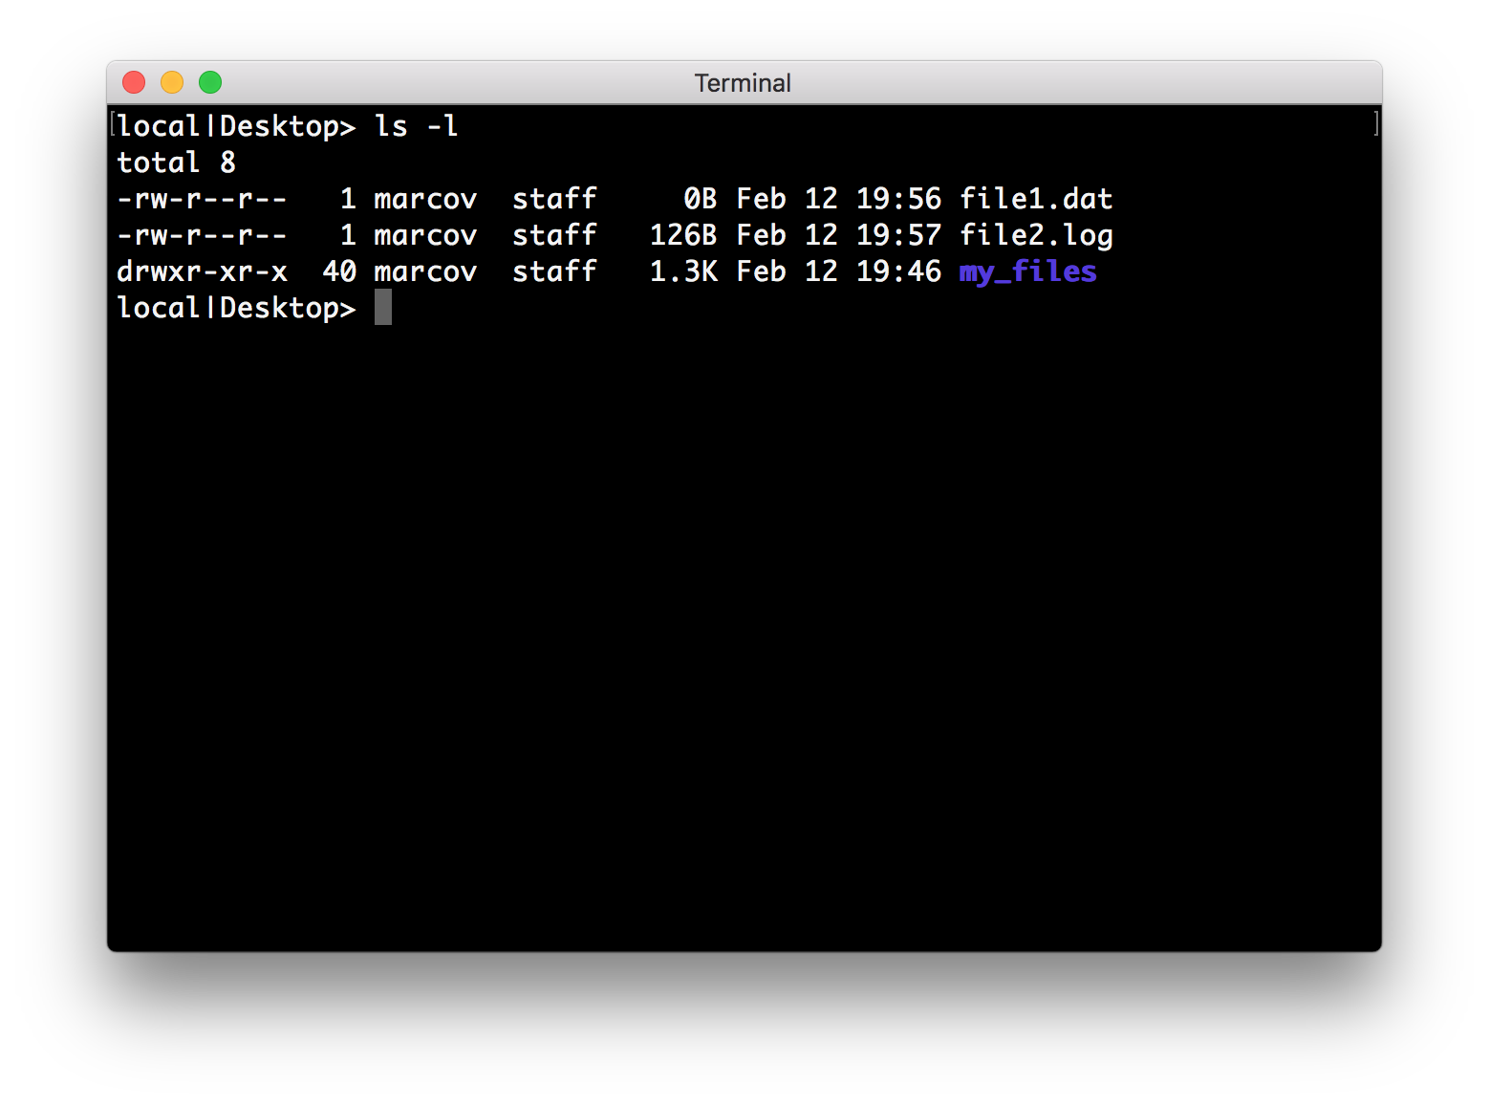
Login to an HPC system
Terminal – Command line

Slide 18
Login to an HPC system
SSH, or Secure SHell
establishing a cryptographically secured connection
authenticating each side to the other
passing commands and output back and forth
$ ssh nct0004@mn1.bsc.es
Password:

Slide 19
Login to an HPC system
SSH, or Secure SHell
establishing a cryptographically secured connection
authenticating each side to the other
passing commands and output back and forth
username
$ ssh nct0004@mn1.bsc.es
Password:
Marenostrum login node

Slide 20


Login to an HPC system
SSH - Authentication and security
Username/password (Symmetric encryption)
Public and private keys (Asymmetric encryption)
Private
Public
Public
Client
Server

Slide 21
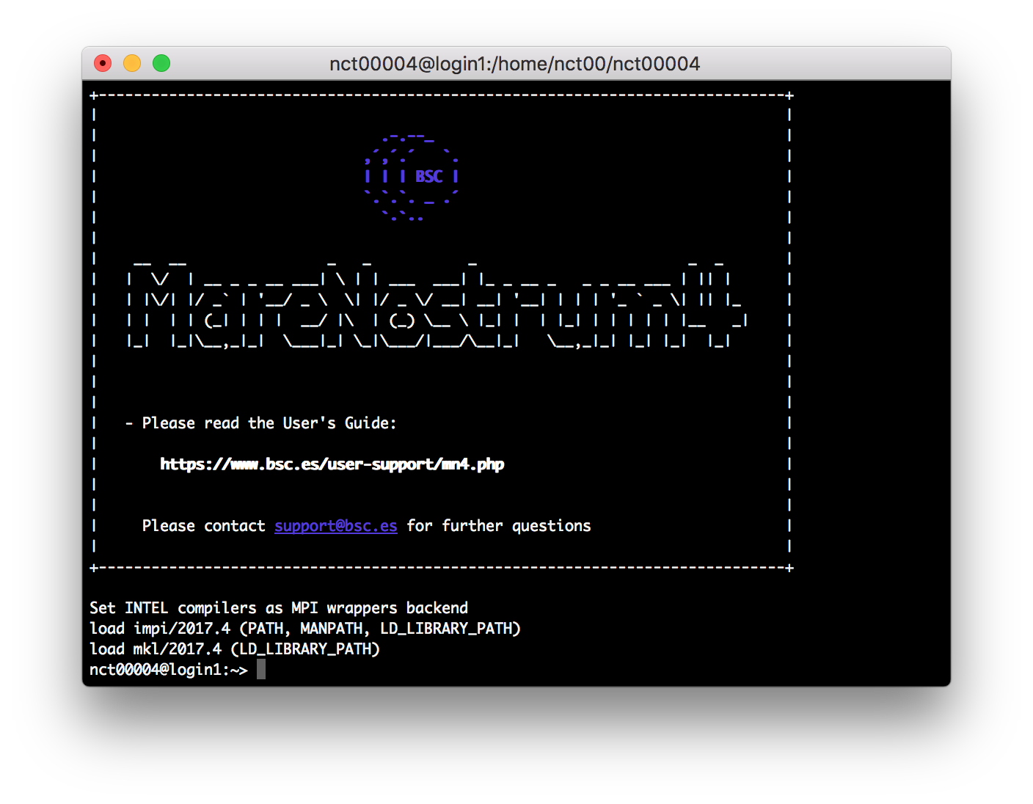
Login to an HPC system
You are logged in!

Slide 22
Login to an HPC system
MareNostrum4
3456 nodes with a grand total of 165,888 processor cores and 390 Terabytes of main memory.
Compute nodes are equipped with:
2 sockets Intel Xeon Platinum 8160 CPU with 24 cores each @ 2.10GHz
L1d 32K; L1i cache 32K; L2 cache 1024K; L3 cache 33792K
96 GB of main memory 1.880 GB/core
(216 nodes high memory, 10368 cores with 7.928 GB/core)
100 Gbit/s Intel Omni-Path HFI Silicon 100 Series PCI-E adapter
10 Gbit Ethernet
200 GB local SSD available as temporary storage during jobs

Slide 23
Getting started with HPC
Linux basic commands
Introduction to HPC in Computational Modelling

Slide 24
Linux basic commands
What is UNIX?
Operating System
Program that controls all other parts of a computer system
Allocates computer’s resources and schedules tasks
Allows the user to use the facilities provided by the system
Essential to all computer systems
Multi-User and Multi-Tasking
Multiple users have multiple tasks running simultaneously
Designed to be machine independent
Setup as a software development environment
Suitable for scientific applications

Slide 25

Linux basic commands
After successful login
Now the system is ready to accept commands
nct00004@login1:~>
Host name
Login name

Slide 26
Linux basic commands
First command
A little bit more
nct00004@login1:~> date
Wen Feb 14 11:00:00 CET 2018
nct00004@login1:~>
nct00004@login1:~> uname -a
Linux login1 4.4.103-92.56-default #1 SMP Wed Dec 27 16:24:31 UTC 2017 (2fd2155) x86_64 x86_64 x86_64 GNU/Linux
nct00004@login1:~>

Slide 27
Linux basic commands
Structure of a unix commands
nct00004@login1:~> mkdir –p dir1/subdir
Arguments
Taken as input by the program.
Command
The UNIX shell (bash) tries to find a program called ‘mkdir’ and takes care that the system executes it.
Options
Passed to the command as a parameter(s) to change its default behavior.
Case-sensitive (everything!)
Spaces used to separate command, options and arguments

Slide 28
Linux basic commands
Where to find help?
--help flag
man built-in command
info built-in command
nct00004@login1:~> uname --help
nct00004@login1:~> man uname
nct00004@login1:~> info uname

Slide 29
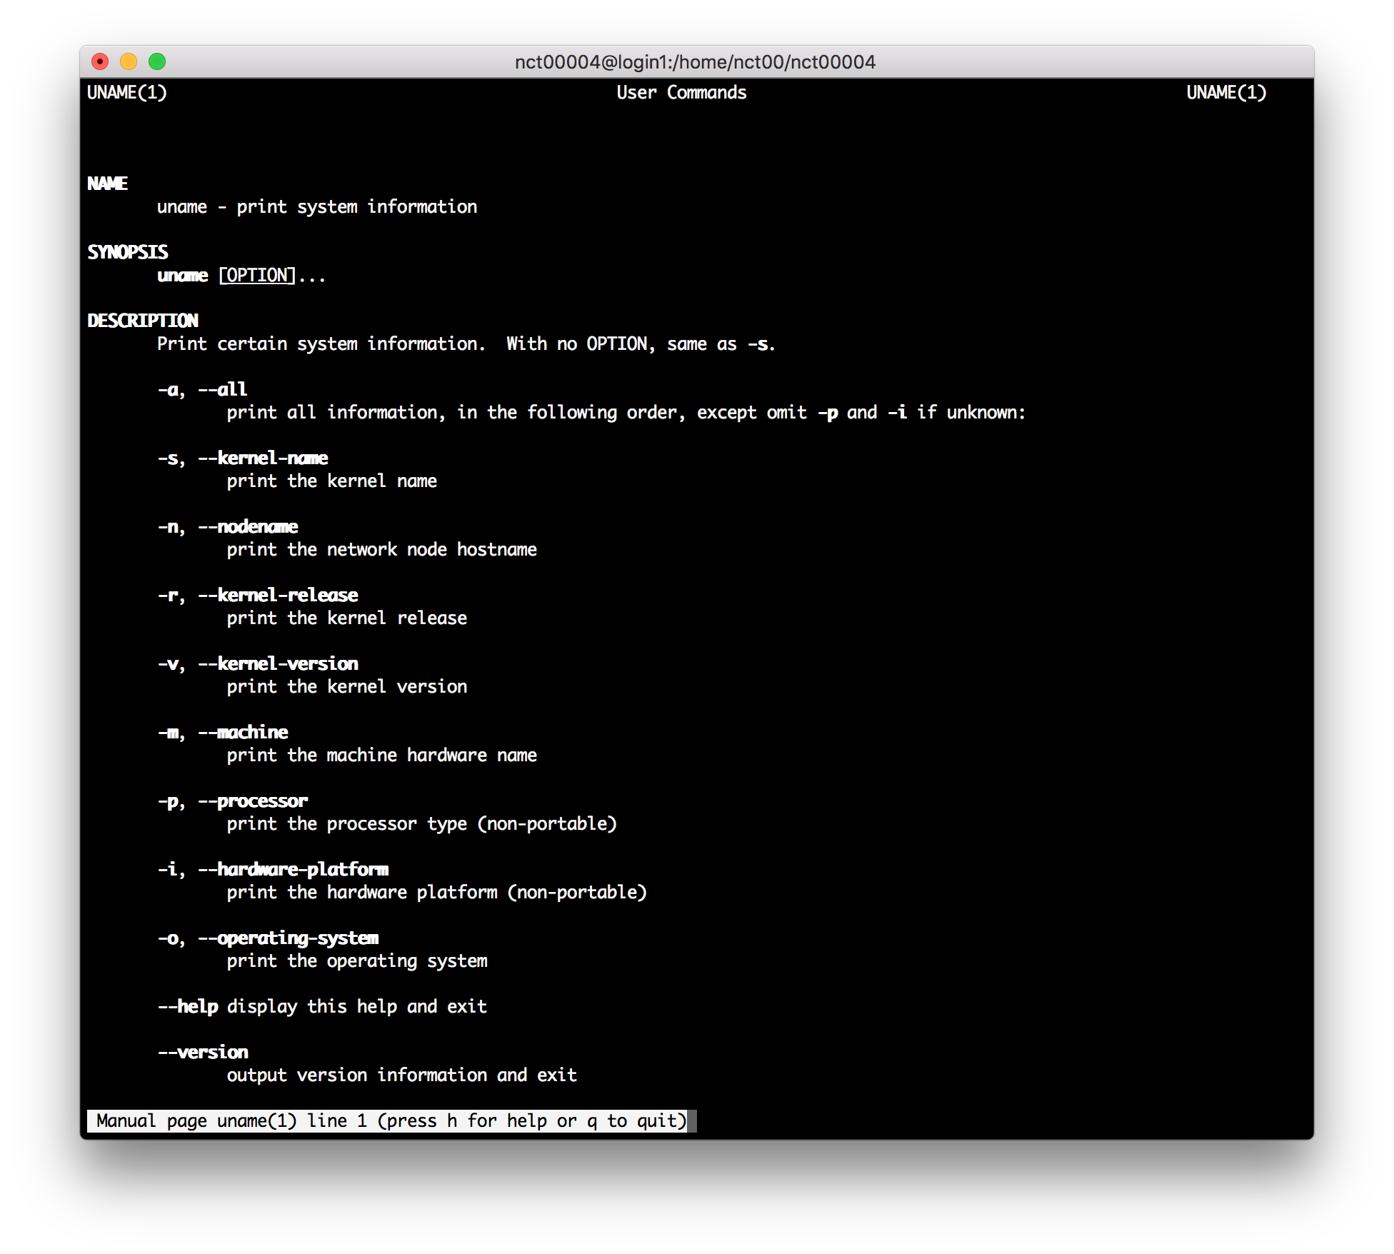
Linux basic commands

Slide 30
Linux basic commands – Looking around
Where I am?
What files are there?
nct00004@login1:~> pwd
/home/nct00/nct00004
nct00004@login1:~> ls
bin file1.txt file2.log
nct00004@login1:~> ls -l
total 0
drwxr-xr-x 2 nct00004 nct00 4096 May 5 2010 bin
-rw-r--r-- 1 nct00004 nct00 0 Feb 13 01:17 file1.txt
-rw-r--r-- 1 nct00004 nct00 1528 Feb 13 01:17 file2.log

Slide 31
Linux basic commands – Moving around
Changing directory
Going “on level” up
Going back to home folder (~)
nct00004@login1:~> cd dir/subdir
nct00004@login1:~/dir/subdir>
nct00004@login1:~/dir/subdir> cd ..
nct00004@login1:~/dir>
nct00004@login1:~/dir/subdir> cd
nct00004@login1:~>

Slide 32
Linux basic commands – Moving around
Path to folders and files
Relative path
Absolute path
nct00004@login1:~> ls dir/mydata.out
dir/mydata.out
nct00004@login1:~> ls ~/dir/mydata.out
/home/nct00/nct00004/dir/mydata.out

Slide 33
Linux basic commands – Files management
Directories
Create directories
Remove directories (only if empty)
Remove directory and its content (be careful with rm)
nct00004@login1:~> mkdir dir
nct00004@login1:~> rmdir dir
nct00004@login1:~> rm –r dir

Slide 34
Linux basic commands – Files management
Files
Copy files
Copy files to directories
Move files
nct00004@login1:~> cp file1.txt file1.copy
nct00004@login1:~> cp file1.* dir/
nct00004@login1:~> mv file1.txt dir/file.txt.new

Slide 35
Linux basic commands – Files management
Files (remote)
Copy files from your local machine to a remote host
Copy files from remote host to local machine
Copy folder from your local machine to a remote host
~> scp file*.txt nct00004@mn1.bsc.es:/home/nct00/nct00004/
~> scp nct00004@mn1.bsc.es:/home/nct00/nct00004/dir/mydata.out .
~> scp –r dir nct00004@mn1.bsc.es:

Slide 36
Linux basic commands
File editing/viewing
touch: Creates a blank file with a specified name.
less: View contents of specified file, page by page.
cat: Display contents of a file.
head/tail: Displays the first/last 10 lines of a file.
System tools
history: Display a listing of the last commands you've run.
find: Search files and directories.
tar: Compress and extract files.
top: Display processes running on the system.
…

Slide 37
Bash scripting
What if I want to run many bash commands?
…maybe in a workflow?
Bash scripts
A Bash script is a plain text file which contains a series of commands.
Any command you can run on the command line can be put into a script (v.v.)
It will be executed like a normal program: ./script.sh

Slide 38
Bash scripting
nct00004@login1:~> ls -l
total 0
drwxr-xr-x 2 nct00004 nct00 4096 May 5 2010 bin
-rw-r--r-- 1 nct00004 nct00 0 Feb 13 01:17 file1.txt
File permission
Every file/directory has 9 permission bits associated (+ initial to diff):
3 user based permission groups: owner(2-4), group(5-7), all users(8-10)
x3 permission types: read(r), write(w), execute(x)
Permission can be changed with the command chmod
nct00004@login1:~> chmod u+x simple.sh

Slide 39
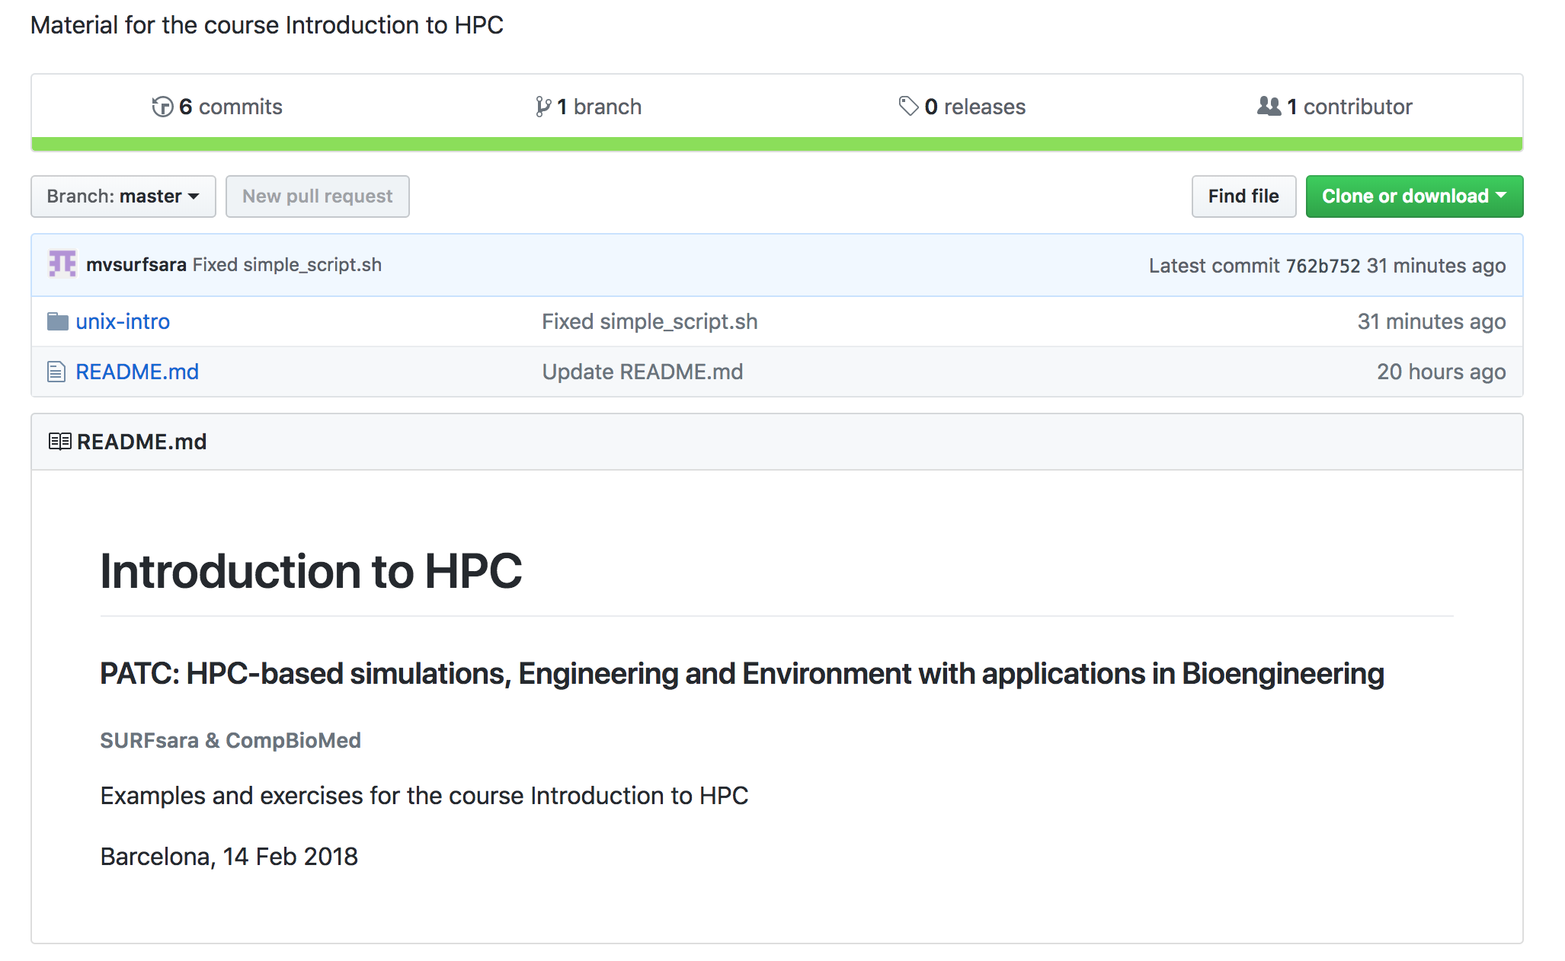
Training material
The material for this course is available at : http://bit.ly/PATC_HPC

Slide 40
Training material
The material for this course is available at: http://bit.ly/PATC_HPC
Transfer the zip file to MarenostrumIV
(Windows users can use MobaXterm or Winscp)
Extract the zip in your home:
~> scp IntroHPC_PATC_CBM-master.zip nct00004@mn1.bsc.es:
nct00004@login1:~> unzip IntroHPC_PATC_CBM-master.zip

Slide 41
Bash scripting
Simple bash script
unix-intro/simple.sh
#!/bin/bash
echo "Hi, I'm your first script."
echo
lscpu --help > cpu.log
lscpu >> cpu.log
echo "I've left something for you."
echo "Ciao"

Slide 42
Bash scripting
Standard input, output and error
Every program (bc, shell, ...) has three predefined input/output associated:
Standard input (stdin): normally your keyboard
Standard output (stdout): normally your screen
Standard error (stderr): normally your screen
These can be redirected to a file or to another command.
nct00004@login1:~> echo "3/0" | bc > calc.log

Slide 43
Bash scripting - Ex
Simple bash script
unix-intro/simple.sh
More complicated bash script
unix-intro/advanced.sh

Slide 44
RUNNING JOBs
Introduction to HPC

Slide 45
Batch system
ssh
Job
Submission
Batch scheduler
Login Node
USER
Shared
Filesystem
Compute
Nodes

Slide 46
Batch system
Supercomputers use batch systems to distribute computational tasks over the available nodes.
Instead of executing commands interactively, you prepare a job script
Script containing the commands to execute
Resource characteristics (specific)
The batch system is responsible for allocating cores, processors or nodes to a job.

Slide 47
Batch system
Advantages of a batch system are:
It allows to run MANY jobs at the same time.
The system takes care that they are run efficiently on the available resources.
Multiusers, queue system.
A batch system allows users to always submit jobs, even if a lot of people are using the system at the same time. In addition take care of budgeting and fair resource usage.
System load balance.
The system takes care of balancing the load across nodes and during time. In a batch system, most jobs may be submitted during office hours, but the scheduler will continue to start jobs at night as nodes become available.

Slide 48
Batch system
Queues
There are several queues present in the machines and different users may access different queues.
nct00004@login1:~>bsc_queues
QUEUE NAME MAX TIME MAX PROC
debug 02:00:00 768
interactive 02:00:00 4
training 2-00:00:00 768

Slide 49
Batch system
Submitting jobs with SLURM
The method for submitting jobs is to use the SLURM sbatch directives directly.
- submits a “job script” to the queue system:
- shows all the submitted jobs ant their status:
- remove the job from the queue system:
- run a command on the cluster
nct00004@login1:~> sbatch <job script>
nct00004@login1:~> squeue
nct00004@login1:~> scancel <jobid>
nct00004@login1:~> srun <command>

Slide 50
Batch system
SLURM Job directives
A job script must contain directives to inform the batch system about the characteristics of the job. This directives appear as comments (#SBATCH) in the job script and have to conform with the sbatch syntax.
#SBATCH --nodes=<num> request for <num> compute node
#SBATCH --ntasks=<num> the number of processes to start
#SBATCH --time=DD-HH:MM:SS total wall clock time of the job
#SBATCH --qos=<queue> requesting a specific queue
#SBATCH --task=<queue> requesting a specific queue
#SBATCH --output=<file> name of the file where std out is printed
#SBATCH --tasks-per-node=<num>
#SBATCH --cpus-per-task=<num>

Slide 51
Batch system - Ex1
SLURM sequential
batch-sys/slurm1.sub
SLURM multinode
batch-sys/slurm2.sub

Slide 52
Software stack
Some software packages require certain settings in your user environment, like paths and environment variables.
Environment Modules
Provide lots of useful software packges
In many different versions
Maintained by experts
Optimized for the architecture
Programming and scripting languages: Python, R, Matlab
Compilers for C, C++, Fortran
Specialized libraries (MKL, OpenMPI)
Scientific codes

Slide 53
Software stack
Useful module commands
module avail list modules
module avail python list all installed versions of python
module load python load the default python version
module load python/2.7.13 load a specific version of python
module unload python unload python
module list list currently loaded modules
MarenostrumIV uses Lmod, a Lua-based module system (TACC)

Slide 54
Software stack
Let’s try it…
List the default loaded modules
Which python I am using?
nct00004@login1:~> module list
Currently Loaded Modules:
1) intel/2017.4 2) impi/2017.4 3) mkl/2017.4 4) bsc/1.0
nct00004@login1:~> which python
/usr/bin/python
nct00004@login1:~> python --version
Python 2.7.13

Slide 55
Software stack
Check which python is installed
nct00004@login1:~> module av python
---------------- /apps/modules/modulefiles/tools -----------------
ANACONDA/5.0.1_python2 python/2.7.13 python/3.6.3_ML
python/2.7.13_ML python/3.6.1 (D)
Where:
D: Default Module
Use "module spider" to find all possible modules.
Use "module keyword key1 key2 ..." to search for all possible modules matching any of the
"keys".

Slide 56
Software stack
List the default loaded modules
Check is working
Have a look at all the software installed on MarenostrumIV with:
module avail
nct00004@login1:~> module load python
load python/3.6.1 (PATH, MANPATH, LD_LIBRARY_PATH, C_INCLUDE_PATH, CPLUS_INCLUDE_PATH, PYTHONHOME)
nct00004@login1:~> which python
/apps/PYTHON/3.6.1/INTEL/bin/python
nct00004@login1:~> python --version
Python 3.6.1

Slide 57
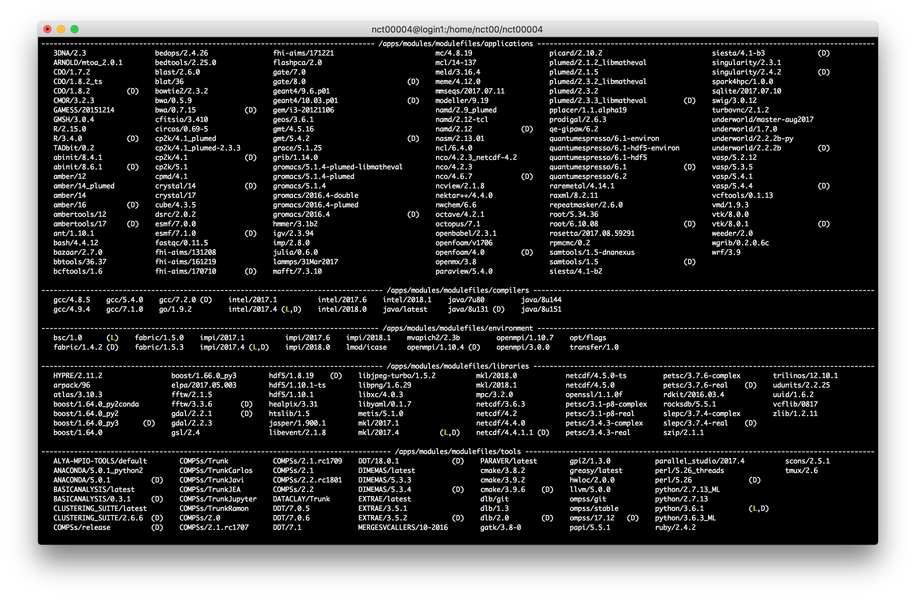
Software stack

Slide 58
File systems
Each user has several areas of disk space for storing files.
These areas may have size or time limits (bsc_quota).
Choose carefully where to store your data!
MarenostrumIV
Root filesystem: Is the filesystem where the operating system resides.
GPFS filesystems: GPFS is a distributed networked filesystem which can be accessed from all the nodes and Data Transfer Machine.
Local hard drive: Every node has an internal hard drive ($TMPDIR).

Slide 59
File systems
The IBM General Parallel File System (GPFS) is a high-performance shared-disk file system providing fast, reliable data access from all nodes of the cluster to a global filesystem.
/apps: Over this filesystem will reside the applications and libraries that have already been installed on the machine.
/gpfs/home: This filesystem has the home directories of all the users, and when you log in you start in your home directory by default. It is highly discouraged to run jobs from this filesystem.
/gpfs/projects: In addition to the home directory, there is a directory in /gpfs/projects for each group of users. This space is intended to store data that needs to be shared between the users of the same group or project.
/gpfs/scratch: Each user will have a directory over /gpfs/scratch. Its intended use is to store temporary files of your jobs during their execution.

Slide 60
Batch system - Ex2
Running python on MarenostrumIV
run-jobs/python_seq.sub
run-jobs/pairwise.py
Using a system installed software (modules)
Make appropriate usage of disk space (scratch)

Slide 61
Running jobs
Parallel jobs
Introduction to HPC in Computational Modelling

Slide 62
Parallel jobs
Serial computing
A problem is broken into a discrete series of instructions, which are executed sequentially on a single processor
credits: https://computing.llnl.gov/tutorials/parallel_com

Slide 63
Parallel jobs
Parallel computing
A problem is broken into discrete parts that can be solved concurrently using simultaneously multiple resources
credits: https://computing.llnl.gov/tutorials/parallel_com

Slide 64
Parallel jobs - Ex
Running python in parallel on MarenostrumIV
batch-sys/python_par.sub
batch-sys/pairwise.py
Exploit background processes in UNIX
& : at the end of a command put the process in bg and let you continue to work
wait : wait that all the background processes have ended before continue

Slide 65
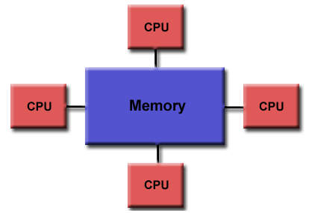
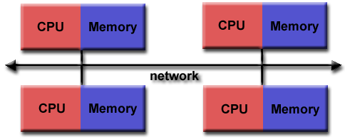
Parallel jobs
Task parallel
many independent runs
needs orchestration
for monte-carlo, parameter sweeps
Shared memory
always within one batch node
uses threads
often implicit
Distributed memory
can use one or more batch nodes
uses separate processes
almost always using MPI
for PDE problems, time stepping
Shared memory topology
Distributed memory topology
credits: https://computing.llnl.gov/tutorials/parallel_com

Slide 66
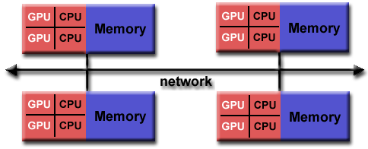
Parallel jobs
Task parallel
many independent runs
needs orchestration
for monte-carlo, parameter sweeps
Shared memory
always within one batch node
uses threads
often implicit
Distributed memory
can use one or more batch nodes
uses separate processes
almost always using MPI
for PDE problems, time stepping
Hybrid topology
credits: https://computing.llnl.gov/tutorials/parallel_com

Slide 67
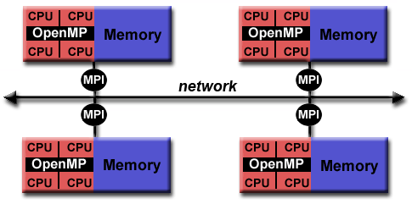
Parallel jobs
Task parallel
many independent runs
needs orchestration
for monte-carlo, parameter sweeps
Shared memory
always within one batch node
uses threads
often implicit
Distributed memory
can use one or more batch nodes
uses separate processes
almost always using MPI
for PDE problems, time stepping
Hybrid topology
credits: https://computing.llnl.gov/tutorials/parallel_com

Slide 68
Parallel jobs - Ex
Running an MPI application
mpi-ex/run_wave
mpi-ex/Makefile
Uses MPI library to distribute work across multiple node.
The code needs to be compiled and right libraries loaded.
It generates a gif that we need to copy back at the end.

Slide 69
Thank you to my colleagues …
Caspar van Leeuwen
Lykle Voort
Zheng Meyer-Zhao
Jeroen Engelberts
Ander Astudillo
Natalie Danezi
Damian Podareanu
Valeriu Codreanu
This project has received funding from the European Union’s Horizon 2020 research and innovation programme under grant agreement No 675451.

